Slide 1
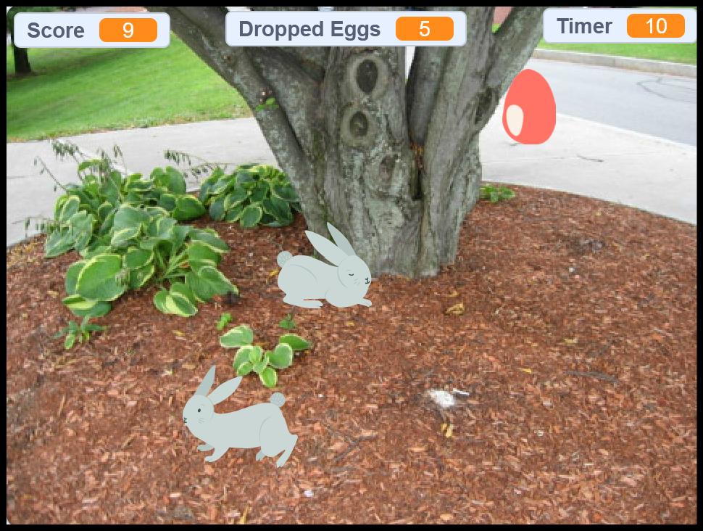
Easter Egg Catch
Wokingham Library Code Club

Slide 2
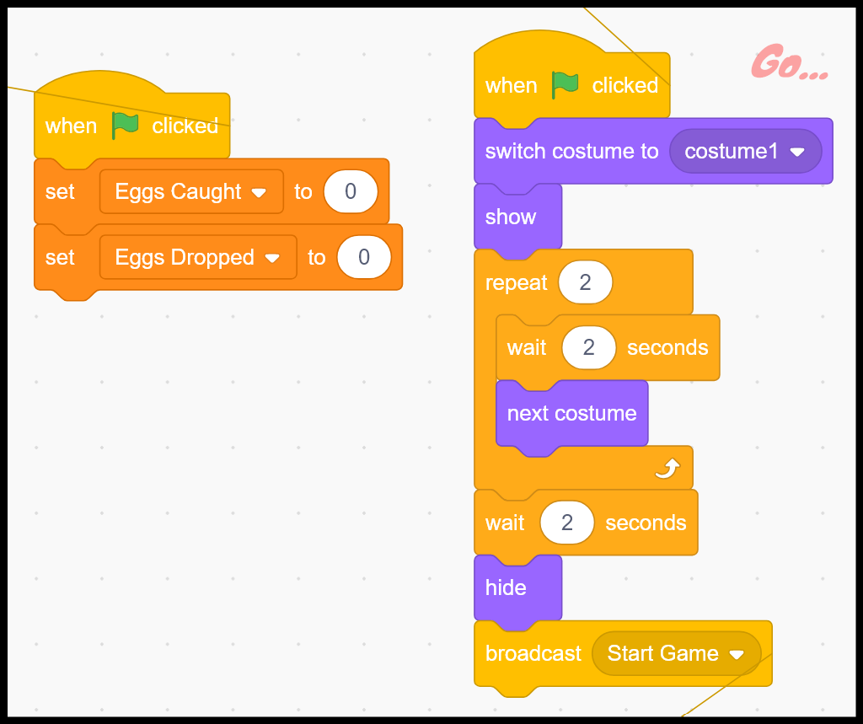
Starting the game
What does this code do?
Can you remember how to create new variables?
Can you remember how to make broadcast messages?

Slide 3
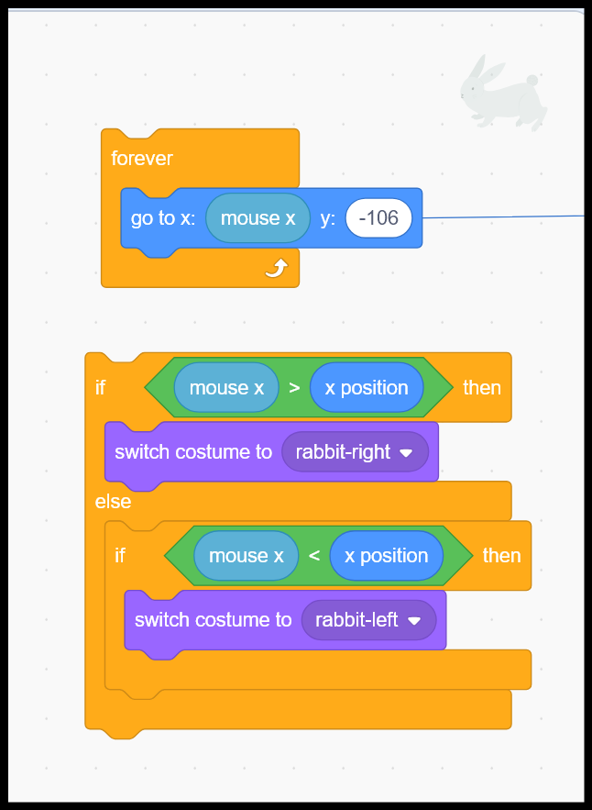
Making the ‘catcher’ rabbit follow the mouse
What do these pieces of code do?
Which event should go before the ‘forever’ block?
Where should the 2nd code snippet go?
Where do you find the ‘mouse x’ & ‘x position’ variables?

Slide 4
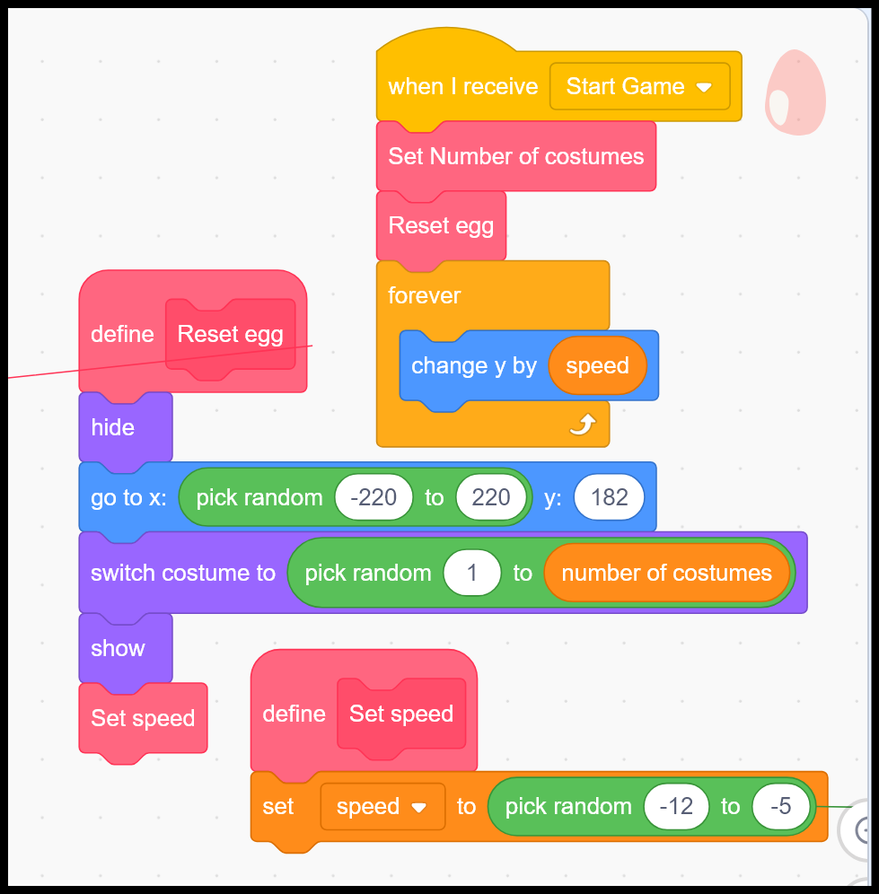
Falling eggs
What do these pieces of code do?
Can you remember how to create your own blocks?

Slide 5
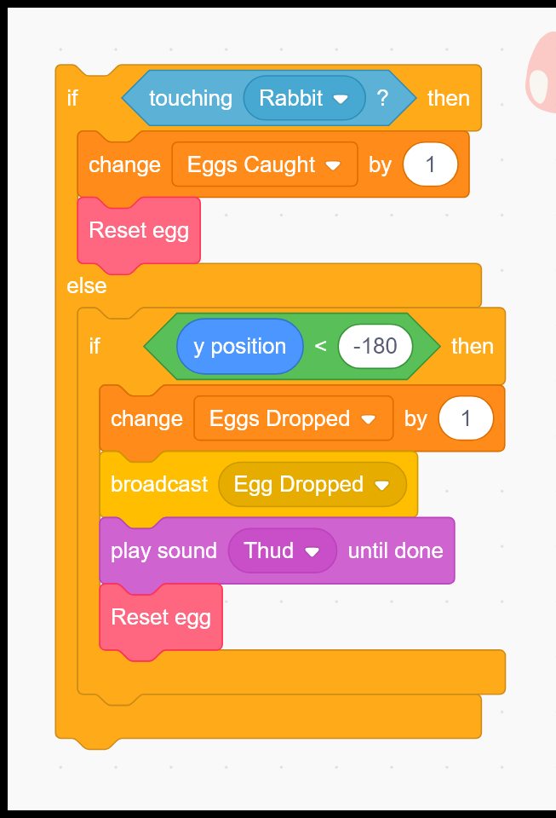
Counting eggs – caught & dropped
What does this code do?
Where do you find the ‘touching’ block?
Where does this code need to go?

Slide 6
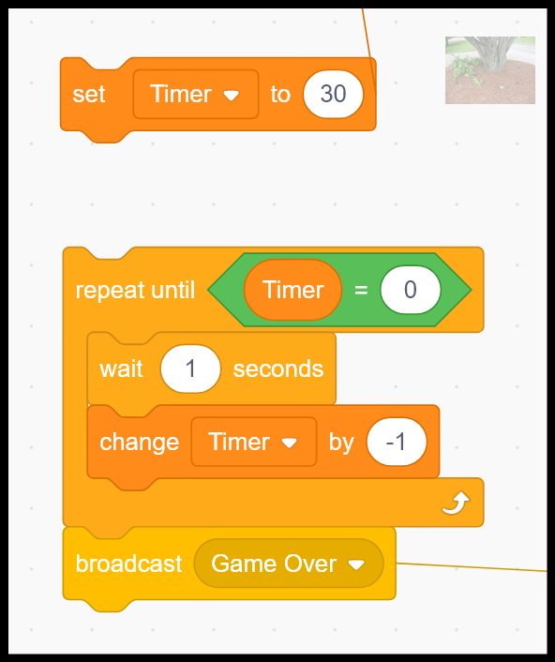
A Timer for the game
Where’s the best place for this code? (The Stage mage be a good place.)
Which events should each snippet of code respond to?
What value will you set Timer to?
Compare this timer with the one you did for the St David’s Day project.

Slide 7
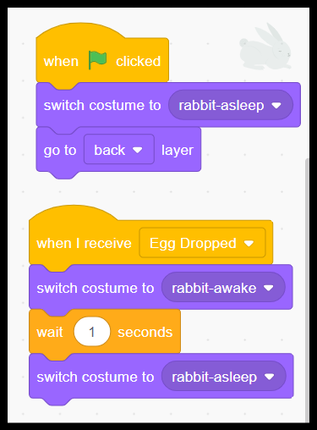
Making the ‘sleepy’ rabbit wake up
What do these pieces of code do?
What effect does ‘go to back layer’ have?

Slide 8
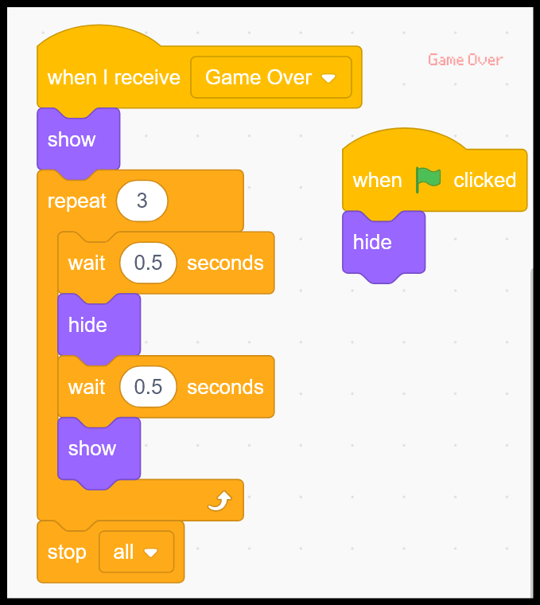
Ending the game
What does this code do?
What does ‘stop all’ do?
The egg sprite may also need to process the ‘Game Over’ message. Do you know why?

Slide 9
Remember to
save and test each bit of code as you go
debug if things aren't working as you expect
think through what you want to happen
check hide and show or go to if things aren’t where they’re supposed to be

Slide 10
When you have finished the coding…
Add additional levels – e.g for each new level:
make the ‘bat’ smaller
make the eggs drop faster
make different sized eggs
Have more than one egg dropping at the same time
Allow the game to use the keyboard instead of the mouse

Slide 11
Add your finished projects to our WLCC studio. Share it first.
https://scratch.mit.edu/studios/35685710/
Or search for the WLCC 2024-25 studio inside Scratch.
Have fun playing each other’s games! Who gets the best score?

